Slide 1
Towards a Data Platform for Analyzing Social Media
Listening to the Whole World and Making Sense of It
Rui Li
ruili1@illinois.edu
University of Illinois at Urbana - Champaign
Notes:
Good morning, today I would like to share my PhD research on analyzing social media so that we have a new way of listening what people are talking about.

Slide 2
Why do we want to analyze social media?
Notes:
To motivate my talk, I would like to answer a simple question in the following slides.
Why do we want to analyze social media?

Slide 3







Social media services have emerged and become a popular information channel
500 million registered users
340 million tweets everyday
We will focus on Twitter in today’s talk.
Other media will have similar applications as Twitter
Notes:
As shown here, today many social media services, such as Twitter and Facebook have become a popular information channel for general users to share and consume information.
For example, Twitter, which we will focus on today’s talk, have 500 millions users, and generated 340 millions tweets.

Slide 4
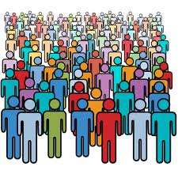
Compared to traditional media, social media have many advantages: broad coverage
Millions of Users
Every Type of Information
Global News
Local Events
Personal Expressions
North Korea cancels peace pact with South in revenge for tough UN sanctions..
Woman in Brigg has handbag stolen from her car: Police issue message about being vigilant following theft
I GOT MY COSTCO CARD. Buy from Costco, Not Walmart! Costco CEO: Raise Minimum Wage To $10 Per Hour
Notes:
Further, such big social media have a lot of unique advantages over traditional media, say, news.
First, it has broad coverage.
Here, I mean social media are created by millions of general users instead of a few reporters
They cover every type of information from global news, like North Korea nuclear test , to local events (car theft in neiborhood), to even more fine-grained information personal feeling about news.
It is a rich resource to mine.
Information also cover various domains.

Slide 5
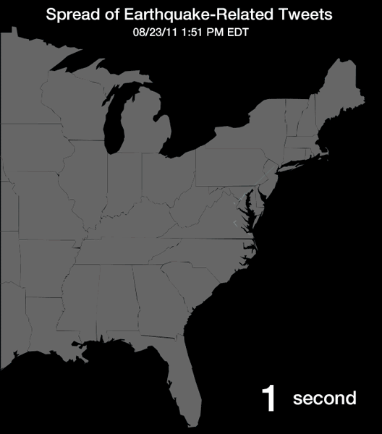
Compared to traditional media, social media have many advantages: freshness
Tweets travel faster than earthquake waves!
picture from http://www.theatlantic.com
Notes:
The second advantage of social media is its freshness.
With the wide of mobile interfaces and the large number of users, social media generated instantly and propage very fast.
Here, the picture of how faster earth-quake related tweets are generated after the earth quake in 2011 in DC area. The speed of tweets is faster than earth quake. wavses
It is ideal resources for finding new issues/

Slide 6




Compared to traditional media, social media have many advantages: rich information
Besides text, social media associate with many additional information.
I GOT MY COSTCO CARD...I LIKE IT. Buy from Costco,
Past Activities
Went to WalMart yesterday and get three nice shoes.
User Profile
Gender: Female
Age: Young
Location: Urbana IL
Occupation: Student
Social Network
Notes:
The third advantage is rich information.
A tweet
Is not only a text messange.
It associates a real user, the user is associated with profiles.
Further, the users activities, and social network,
We also us to do complex analysis..

Slide 7
With these advantages, social media provide tremendous opportunities for listening what people are talking about?
Notes:
To be more concrete about what opportunities are , I would like to give more examples in the following slides.

Slide 8
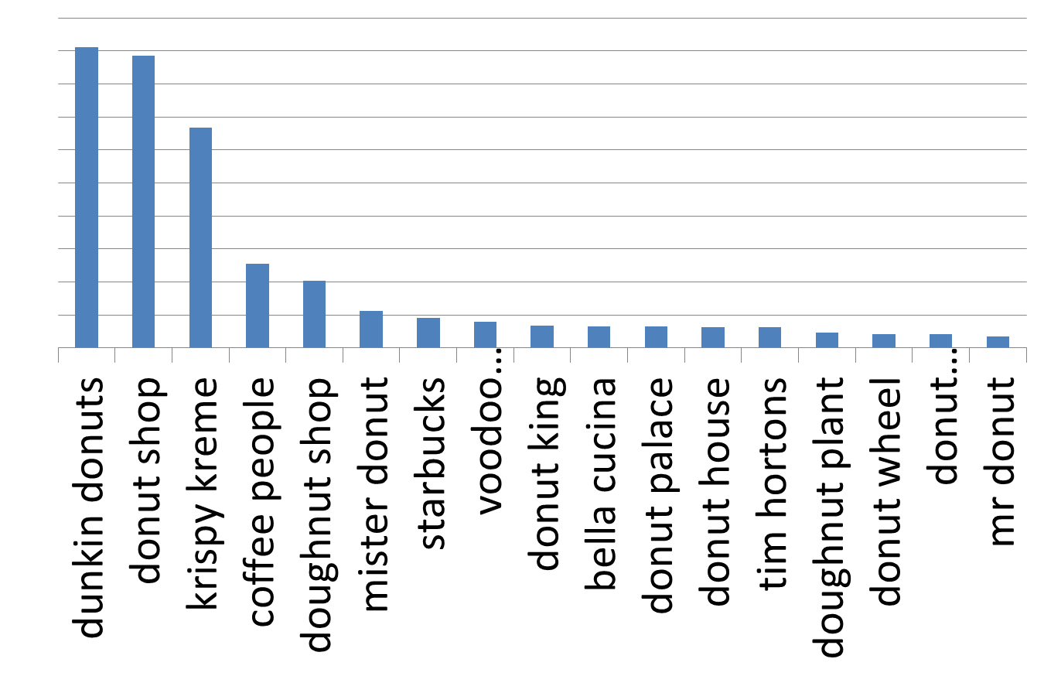
Business Intelligence: understand their customers without time consuming surveys
What are popular demographics of users who mention “IPhone 5”.
What places do people get “donuts”?
What smartphones do young female in Christmas mention?
Where do people get donuts?
Picture from Emre Kiciman
Notes:
First in the business intelligence domain
By mining social media, business owners can understand their customers and markets without doing surveys.
On one hand, by mining tweets, we can know thee age groups of users who like iphone, or where do people get donuts.

Slide 9
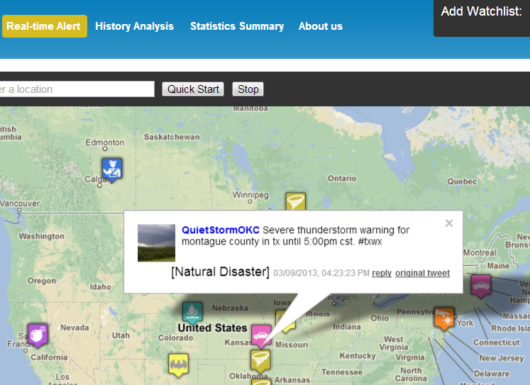
Emergency management: detect emergency events timely and analyze their patterns
What crime related events are happening now?
What regions are most affected by certain types of events last summer?
Disaster and Crime Detection
Our TEDAS Demo at ICDE 2012
Spatial-Temporal Patterns of Tornado
Our TEDAS Demo at ICDE 2012

Slide 10
Demo: Twitter based Event Detection and Analysis System (TEDAS) [ICDE 2012]
http://canary.cs.illinois.edu/crimedetection/

Slide 11
There are two challenges for effectively analyzing social media in general
Social media are big!
340 million tweets everyday
500 million users
Social media are Noisy!
40.1% of tweets are pointless babble.
84% of users do not have complete profiles.

Slide 12
Due to the challenges, current approaches remain many limitations
Current solutions take a simplistic way.
How to process big social media efficiently ?
To collect data, they collect a small set of samples or search relevant tweets with manually selected keywords.
They will miss many relevant data.
Current solutions are lack of generality.
Most applications share similar of functions, but those functions are studied in their own context.
Collecting relevant tweets from the Twitter stream
Profiling Twitter users’ missing attributes
Classifying tweets

Slide 13



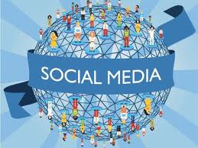

How can we generally support key functions of various applications effectively?
My Proposal -- BigSocial Data Platform
Application Layer
Business Intelligence
Emergency Management
Political Analysis
similar to document search, but more complex
Query Processing Layer
Complex Search Queries
Plans
Index-Plan Optimizer
Indexes
Data Augmentation Layer
similar to preprocessing, but new tasks.
User Attributes
Attributes
User Profiler
Doc Attributes
Document Analyzer
Similar to crawling, but without hyperlink
Data Gathering Layer
Data Corpus
Topic
Topic Focused Monitor
We take Twitter as an example to study.
Notes:
Given social media, we want to enable various applications?
How could filling the ess components to realize those applications.
Emphze social media

Slide 14
My Research: solve real-world problems in various components of a platform.
Application Layer
Detect and Analyze Crime Events [ICDE’12]
Queries
Business Intelligence
Emergency Management
Political Analysis
Results
Query Processing Layer
I am working on the indexing problem.
[In Preparation]
Complex Search Queries
Plans
Index-Plan Optimizer
Indexes
Data Augmentation Layer
Profile User Location [KDD’12, VLDB’12], Classify Web objections [KDD’09]
User Attributes
Attributes
User Profiler
Doc Attributes
Document Analyzer
Data Gathering Layer
Monitoring topic-related tweets
[VLDB’13 Sub]
Data Corpus
Topic
Topic Focused Monitor
Exploring Social Media Exploration [WWW ‘07] (Best student paper candidate), Mining Competitors from Web [ICDM’07,TKDE], and Query Recommendation [CIKM’11].

Slide 15
This talk: we will discuss two real-world problems
[ICDE’12]
Application Layer
Queries
Business Intelligence
Emergency Management
Political Analysis
Results
[In Preparation]
Query Processing Layer
Complex Search Queries
Plans
Index-Plan Optimizer
Indexes
Propose some new research problems for future study.
[KDD’12, VLDB’12, KDD’09]
Data Augmentation Layer
User Attributes
Attributes
User Profiler
How to mine user information from noisy social media data?
Doc Attributes
Document Analyzer
Data Gathering Layer
[VLDB’13 Sub]
How to efficiently process big social media data?
Data Corpus
Topic
Topic Focused Monitor

Slide 16
An Automatic Topic-Focused Monitor for Big Social Media (Twitter Stream)
[ICDE’12]
Application Layer
Queries
Business Intelligence
Emergency Management
Political Analysis
Results
[In Preparation]
Query Processing Layer
Complex Search Queries
Plans
Index-Plan Optimizer
Indexes
[KDD’12, VLDB’12, KDD’09]
Data Augmentation Layer
User Attributes
Attributes
User Profiler
Doc Attributes
Document Analyzer
Data Gathering Layer
[VLDB’13 Sub]
Data Corpus
Topic
Topic Focused Monitor

Slide 17
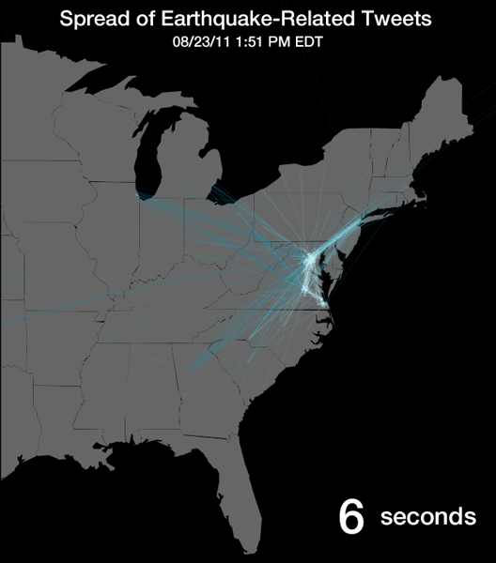

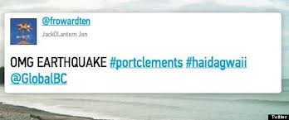
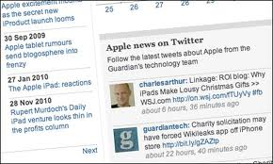

Monitoring social media is essential to many applications
Emergence Management
Business Intelligence
Social Media

Slide 18
It is inefficient and useless to collect and process the entire social media
Social media are big!
300 million tweets generated per day.
Only a small percent is useful for an application
40.1% are pointless babble.
E.g., 0.05% are relevant to crimes.

Slide 19
How can we find scarce relevant tweets from big social stream in an efficient way?
Automatic Topic-focused Monitor
Most applications use classifiers to automatically determine whether tweets are relevant to a specific application (topic), e.g., crime
To generally monitor for any application, our monitor takes a classifier as input.
To efficiently process social media, our monitor aims to collect most relevant tweets for a topic under some costs as output.
Classifier f
Topic Focused Monitor
Target Data
Input
Output
Available Twitter APIs
.
Many classification models have been proposed, we take a classifier as given.
Social Media Stream
Topic-Focused Monitor
Notes:
In this paper, we take a topic-focused approach.
We observe that many applications use classifiers to automatically determine whether tweets are relevant to a application or not.
To generally support monitoring any application, we take a classifier of an application input,
To efficiently process social media for this task, our monitor collect most relevant relevant tweets that pass the classier as out put.
We note that, as many classification models have been proposed, here, we assume classifier as given.

Slide 20
Ideally, our topic-focused monitor should be optimal and continuous
Optimal: cover as many target tweets as possible under some cost budgets.
Continuous: collect target tweets from the Twitter stream continuously.
Fine-grained Analysis
New contents are emerging
Car Theft at 2nd street!
Hunt for LA shooter stretches police thin as many stay on duty… Feb 2/12 2013

Slide 21

Standard Twitter APIs cannot monitor in a topic-focused way
They represent standard ways of accessing a corpus.
Sample API: returns only 1% percent tweets
It covers 1% of target tweets
Filter API: returns all the tweets matching a given keyword
It misses many target tweets.
Firehose API: returns all public tweets.
It is not available for general public users.
It is inefficient to crawl all tweets.

Slide 22
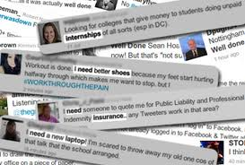

Existing applications use a set of manually selected keywords for focused monitoring
{“police”, “kill”} or {“shoot”, “police”}
Achieve reasonable performance.
Laborious
Unguaranteed Coverage
Outdated

Slide 23
How can we automatically select “optimal” keywords to monitor in a continuous way
Automatic Topic-Focused Monitor (ATM) : sample, optimize track and then repeat
Topic: Crime
Target Tweets: police investigate
…
T1: Good morning…
T2: LA police search..
…
Optimizer
Target Tweets
Sampler
Keywords:
Police, accident
Tracker
Twitter Stream

Slide 24
ATM must address two challenges
Tweets Sampling Task:
Given available Twitter APIs, we need to sample tweets from the Twitter stream to enable accurate estimation.
Keywords Selection Task:
Given a set of samples, we need to select a set of “optimal” keywords to track.
Notes:
Given available Twitter APIs, we need to sample tweets from the Twitter stream to enable accurate estimation.
Given a set of samples, we need to select a set of “optimal” keywords to track.

Slide 25
Tweet sampling task: sample random and sufficient tweets with limited and biased APIs
There are two requirements for sampling tweets.
Sufficient
Random
The available APIs do not meet the requirements..
Sample API is limited.
Filter API is biased.
We formally give a theorem about how many samples we need.

Slide 26
Our Approach
To enable sampling extra random tweets with the biased (filter) API, we integrate random walk and rejection sampling methods.

Slide 27





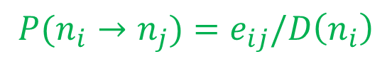
Random walk sampling samples nodes from a graph G (N, E)
Step 1
Step 2
1
1/2
1
1
1/2
1
1/2
1/2
$$P(n_{i}→n_{j})=e_{ij}/D\left(n_{i}\right)$$
Step 3
1
Step 4
1/2
1
1
1/2
1
1/2
1/2
If G is ergodic, random walk converges to a distribution φ

Slide 28
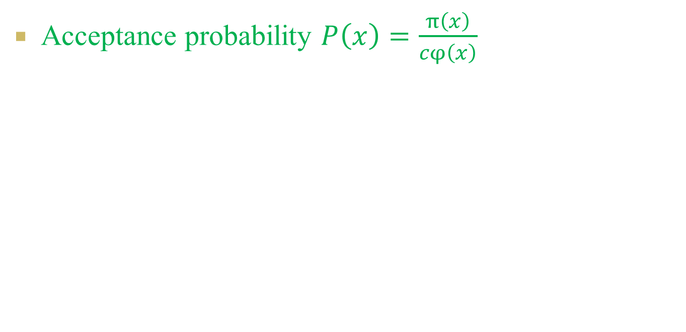
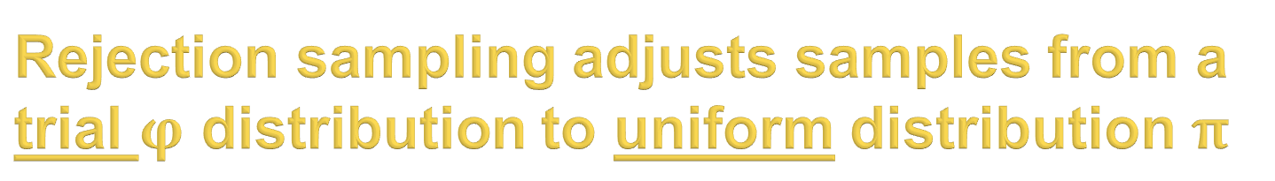
Rejection sampling adjusts samples from a trial $φ$ distribution to uniform distribution $π$
Acceptance probability $P\left(x\right)=\frac{π\left(x\right)}{cφ\left(x\right)}$

Slide 29
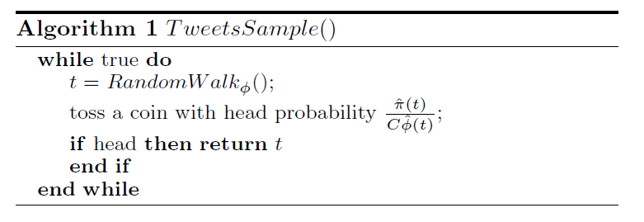
Our sampling algorithm
Q1:How to conduct random walk?
Q2: How to derive φ and C?
We need to design the tweet graph.

Slide 30
The tweet graph should be operable and ergodic
Operable:
The random walk on the graph can be implemented by the available APIs.
Ergodic:
The random walk on the graph converges to a known distribution.

Slide 31
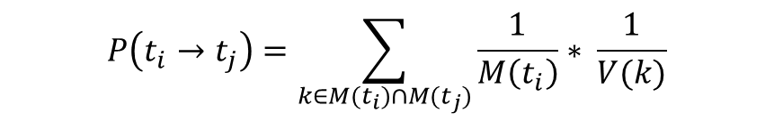
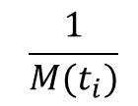
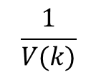
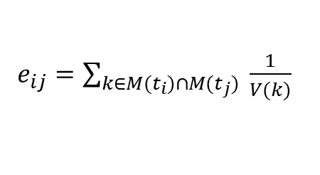
Operable: how to design Twitter graph to enable random walk with the filter API
Filter API -->Connect two tweets by keywords.
k
t_{j}
t_{i}
$$\frac{1}{M(t_{i})}$$
$$\frac{1}{V(k)}$$
k'
$$P\left(t_{i}→t_{j}\right)=\sum_{k∈M(t_{i})∩M(t_{j})}{\frac{1}{M\left(t_{i}\right)}∗ \frac{1}{V(k)}}$$
$e_{ij}=\sum_{k∈M(t_{i})∩M(t_{j})}{ \frac{1}{V(k)}}$
Notes:
To enable random walk on our tweet graph, we need to connect two tweets with the filter API, like how the hyperlinks connects two tweets in a web graph.
Our

Slide 32
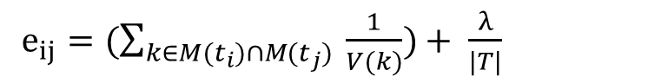
Ergodic: how to design Twitter graph to make sure random walk converge?
However, the graph may not be connected.
At any tweet, we have λ probability to jump to any tweet.
t₁
t_{i}
t₂
t₃
$e_{ij}=(\sum_{k∈M(t_{i})∩M(t_{j})}{ \frac{1}{V(k)})+ \frac{λ}{|T|}}$

Slide 33
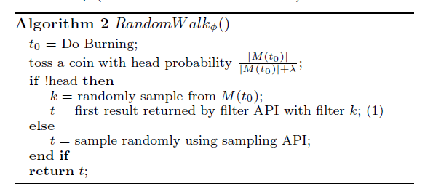
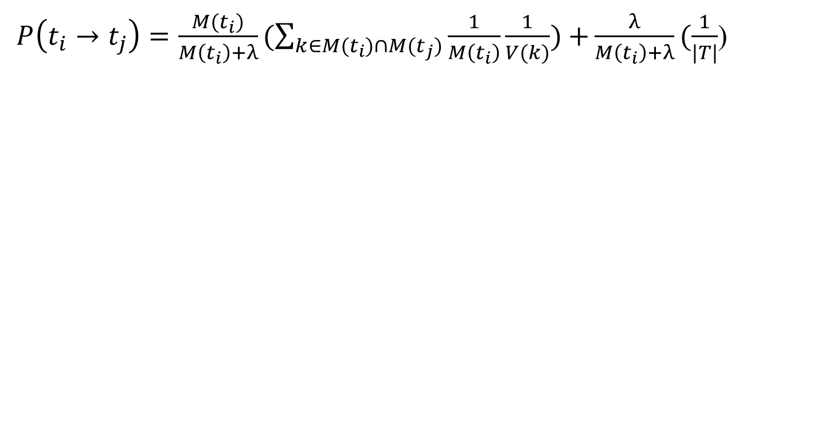
Our random walk algorithm
$P\left(t_{i}→t_{j}\right)=\frac{M(t_{i})}{M\left(t_{i}\right)+λ}(\sum_{k∈M(t_{i})∩M(t_{j})}{\frac{1}{M\left(t_{i}\right)}\frac{1}{V(k)})+}\frac{λ}{M\left(t_{i}\right)+λ}(\frac{1}{|T|}$)
Walk
Jump
A linear combination with λ as the smoothing parameter

Slide 34
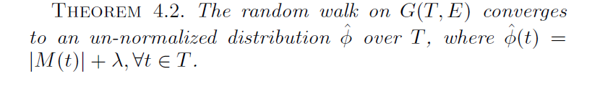
Our random walk will converge to the degree distribution of the Twitter graph

Slide 35
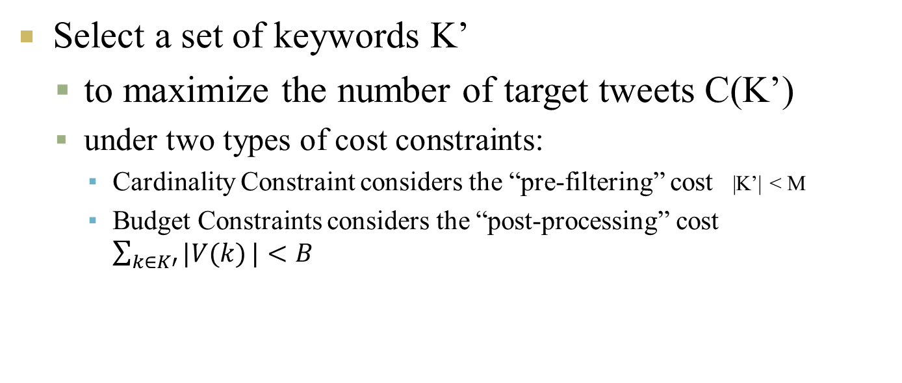
Keyword selection task: efficiently select optimal keywords under cost constraints
We take a constrained optimization approach to model our problem.
Select a set of keywords K’
to maximize the number of target tweets C(K’)
under two types of cost constraints:
Cardinality Constraint considers the “pre-filtering” cost |K’| < M
Budget Constraints considers the “post-processing” cost $\sum_{k∈K′}{|V(k)}|<B$

Slide 36
The problem is NP hard
We formally prove it via reducing a classic NP hard problem, the set cover problem, to it.
How can we select K’ very efficiently?

Slide 37
Contribution 1: we prove that our problem has a desired submodular property.
Maximizing a sub-modular function with budget or cardinality constraint can be solved in a greedy way with a guaranteed approximation rate.
How can we handle two constraints?

Slide 38
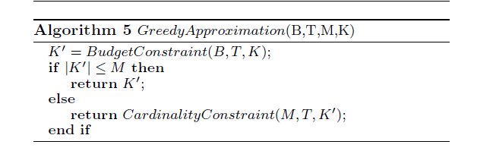
Contribution 2: we extend the current algorithms to handle two constraints
Our algorithm handles multiple constraints one by one.
Handle the budget constraint first
Handle the other constraint if necessary
We also derive the approximation bound for this algorithm

Slide 39
We design a set of experiments to fully evaluate ATM
Use Two Settings
Fixed Corpus of 500 millions of Tweets
Twitter Stream
Test for Two Topics
Building Classifiers for crime and sports
Compare ATM with the state of the art methods

Slide 40
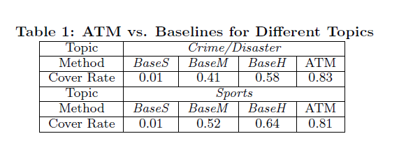
For selecting keywords, ATM significantly improves baseline methods

Slide 41
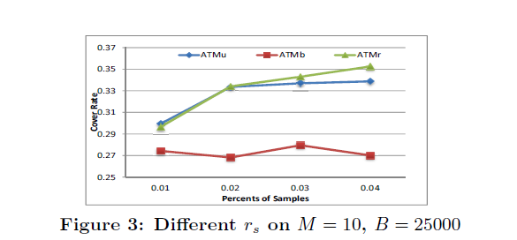
For sampling tweets, ATM samples randomly

Slide 42
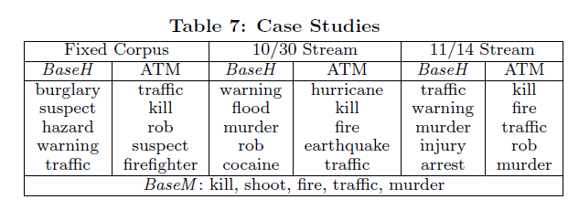
Case study on Twitter stream: ATM selects “optimal” and “continuous” keywords

Slide 43
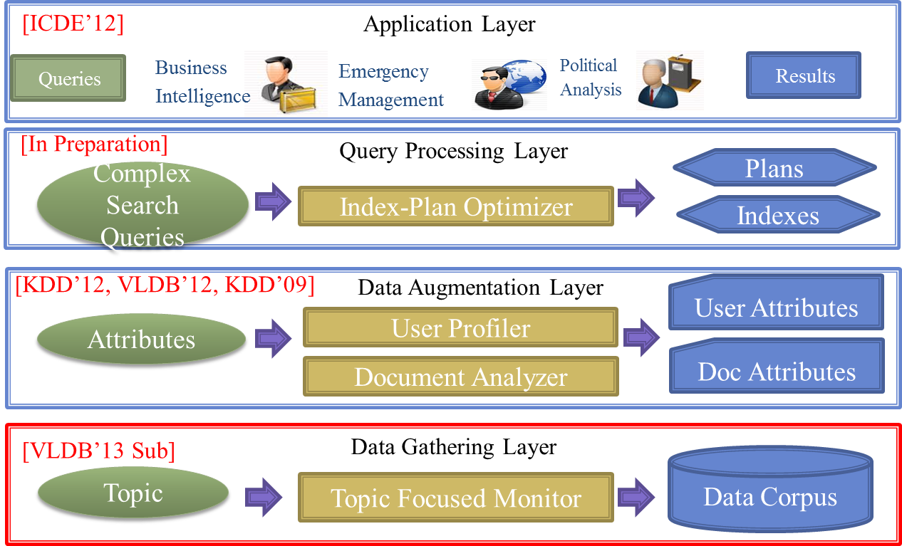
Summary: we propose ATM to monitor big social media data efficiently
A sampling algorithm to sample sufficient and random tweets with limited and biased APIs
An efficient algorithm for selecting optimal keywords under multiple cost budgets.

Slide 44
Profiling User’s Home Locations from Noisy Social Media
[ICDE’12]
Application Layer
Queries
Business Intelligence
Emergency Management
Political Analysis
Results
[In Preparation]
Query Processing Layer
Complex Search Queries
Plans
Index-Plan Optimizer
Indexes
[KDD’12, VLDB’12, KDD’09]
Data Augmentation Layer
User Attributes
Attributes
User Profiler
Doc Attributes
Document Analyzer
Data Gathering Layer
[VLDB’13 Sub]
Data Corpus
Topic
Topic Focused Monitor

Slide 45


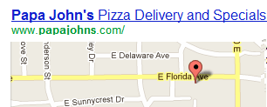

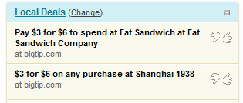


Profiling users’ essential attributes is important for many services
Search Engines
Personalized Search
User
Targeted Advertisement
Advertisers
Richard
Job: Student
Location: Champaign

Slide 46
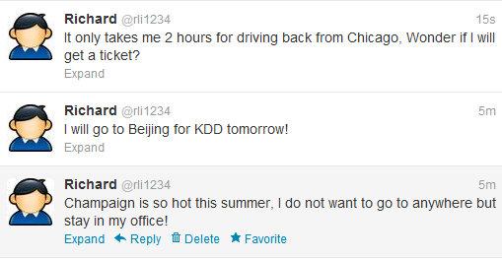





We profile Twitter users’ home locations from tweets and the following network
Output
Profiling a User’s Home Location
A user’s home location is defined as the place where most his activities happen. It is different from a real-time geo position (e.g., Starbucks at green street)
Location: Champaign
Input
In Context of Social Media (Twitter)
User Centric Data (Tweets)
Social Network Data (Following network)
Lady Gaga
Richard
Rob
TechChruch
Jessie
Cindy
Notes:
Here, I am interested in profiling users’ home location in the context of socialmedia.
Here, we define the home location
Specifically, we aim to utilize two types of resources (user centric data) /social network work data) to predict user’s home location
We emphize that this is the first work that profiles users location from network, and text data. Traditional only explore text data only.
While we profile

Slide 47
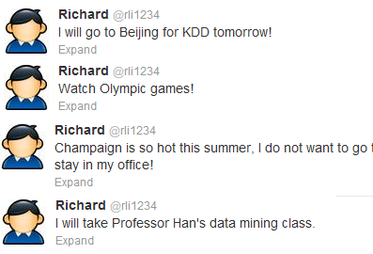

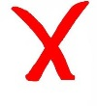
The problem is difficult due to scarce signals
Tweets
Following Network
Richard
Rob
Lady Gaga
New York
Unknown
Jessie
Champaign
TechChruch
Unknown
Cindy
San Francisco
Only 6% messages contains location related terms!
Only 16% users have locations on their profiles!

Slide 48
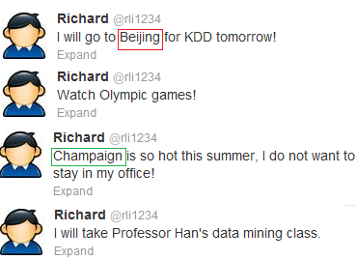
The problem is difficult due to noisy signals
Tweets
Following Network
Richard
Rob
Lady Gaga
New York
Unknown
Jessie
Champaign
TechChruch
Unknown
Cindy
San Francisco
A user tweets about locations different from his home location.
User follows friends who live different locations from his home location.

Slide 49
How can we accurately predict users’ location from noisy and scarce signals?
A unified and discriminative probabilistic framework
Scarce Signal Challenge
Utilize both signals as observations
Profile locations via maximizing the likelihood of observations.
Take a probabilistic approach to model that 1) users from different locations can be connected, and 2) some users are more likely connected.
Noisy Signal Challenge
Take additional user knowledge as constraints

Slide 50
Observation: we unify two types of signals as a directed heterogeneous graph G.
G contains users nodes and venues nodes.
G is a directed graph.
Each node associates with a location.
Head Node
New York
u₂
?
Beijing
Tail Node
U₆
v₁
?
Champaign
u₁
Champaign
v₂
?
u₅
u₃
San Francisco
Unlabeled Node
u₄
Labeled Node

Slide 51
Model: we observe two characteristics for the probability of an edge given two nodes
How likely a tail node n_{j} at L(n_{j}) builds an edge e<n_{i,} n_{j}> a head node n_{i} at L(n_{i})
How likely a user at Champaign will tweet about “Champaign” ?
How likely a user at Champaign will follow a user at Chicago?
Observation 1 The probability decreases as their distance increases
Observation 2 At the same distance, different head (Chicago, Champaign) nodes have different probabilities to attract tail nodes.
Notes:
As, as in the graph, an edge will connect different locations (two nodes will not have the same locations), thus, we use to probability model to capture with there is an edge between two nodes given their locations.

Slide 52
Model: we propose a discriminative influence model to capture the two characteristics
Conceptual level
Discriminative Influence Model θ_{ni}
Influence probabilities decrease from the center.
Different nodes have different influence scope.
Mathematical Level
Gaussian Model

Slide 53
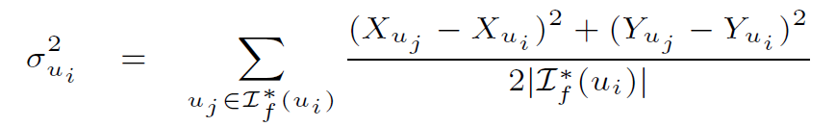
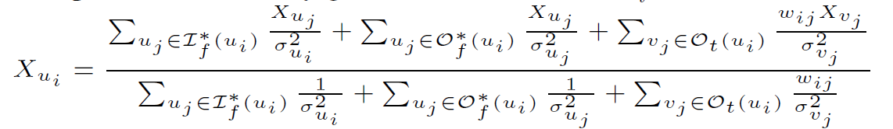
MLE based Inference: an efficient local (online) algorithm with edges from labeled neighbors
only edges from/to his labeled neighbors
simple and efficient
closed-form solution
online
New York
Beijing
u₂
v₁
?
Average Distance of a User’ s Followers
u₁
Influence Scope
Champaign
Champaign
v₂
u₅
San Francisco
User Location
Weighted Average of Different Resources
u₄

Slide 54
MLE based Inference: an accurate global (offline) algorithm with all the edges
The local algorithm only uses limited information.
We utilize all the edges in the graph via profiling all users’ locations together
accurate but complex
iterative algorithm (we prove the convergence)
offline
Beijing
u₂
New York
?
U₆
v₁
?
Champaign
u₁
Champaign
v₂
?
San Francisco
u₅
u₃
u₄

Slide 55
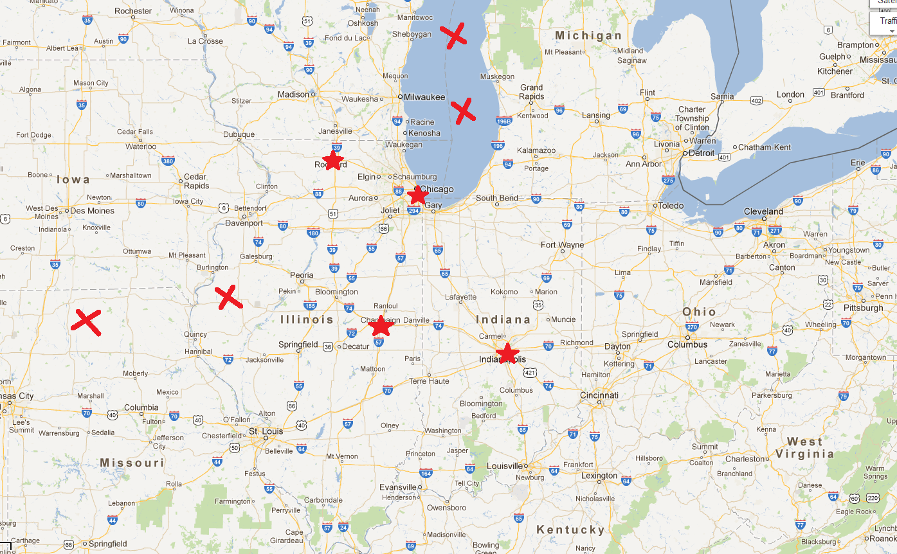
Constraints: we incorporate additional human knowledge.
Additional Knowledge: e.g., users only live in cities or towns
Constrained Optimization: we maximize the likelihood in each method under constraints.

Slide 56
We compare our method with the-state-of-arts methods on a large corpus.
Data Set:.
139K users having locations in their profiles
50 million tweets
2 million following relationships.
Methods:
User-based Location Profiling [WWW10]
Content-based Location Profiling [CIKM10]

Slide 57
The global profiling algorithm can further improve the local profiling algorithm.

Slide 58
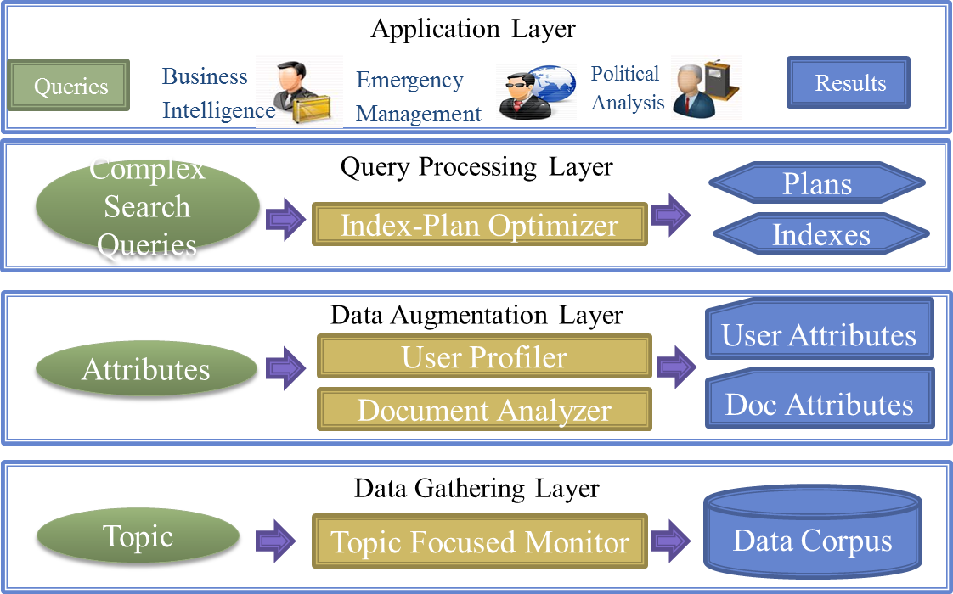
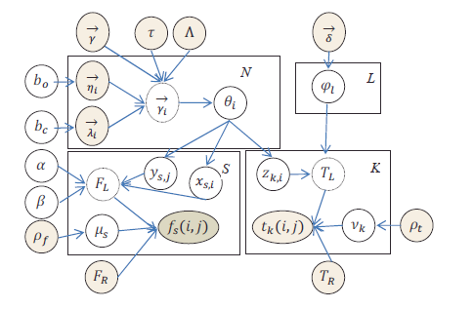
Summary: we present a probabilistic model to profile users from noisy social media.
The model unifies both social network and user-centric data
The model discriminatively models different signals.
The model incorporates additional human knowledge.
We develop online and offline profiling methods.
We further extend our model to profile multiple locations in VLDB.

Slide 59
Future Work
[ICDE’12]
Application Layer
Queries
Business Intelligence
Emergency Management
Political Analysis
Results
[In Preparation]
Query Processing Layer
Support analytical search efficiently
Complex Search Queries
Plans
Index-Plan Optimizer
Indexes
[KDD’12, VLDB’12, KDD’09]
Data Augmentation Layer
User Attributes
Attributes
User Profiler
Extend our profiling models to handle various attributes and incorporate types of relaitonships
Doc Attributes
Document Analyzer
Data Gathering Layer
[VLDB’13 Sub]
Data Corpus
Topic
Topic Focused Monitor

Slide 60
Future work 1: co-profile user attributes and relationship types
[ICDE’12]
Application Layer
Queries
Business Intelligence
Emergency Management
Political Analysis
Results
[In Preparation]
Query Processing Layer
Complex Search Queries
Plans
Index-Plan Optimizer
Indexes
[KDD’12, VLDB’12, KDD’09]
Data Augmentation Layer
User Attributes
Attributes
User Profiler
Doc Attributes
Document Analyzer
Data Gathering Layer
[VLDB’13 Sub]
Data Corpus
Topic
Topic Focused Monitor

Slide 61


We aim to profile general attributes based on social network
Users have multiple attributes
I focus on social network information.
User: u₁
Location: Mountain View
Occupation: Unknown
College: Uni. of Illinois
User: u₂
Location: Cupertino
Occupation: Facebook
College: Uni. of Illinois
User: u₁
Location: Mountain View
Occupation: Google
College: Uni. of Illinois
User: u₃
Location: Sunnyvale
Occupation: Unknown
College: MIT
User: u₄
Location: Mountain View
Occupation: Google
College: Stanford
User: u₅
Location: Seattle
Occupation: Microsoft
College: Unknown

Slide 62
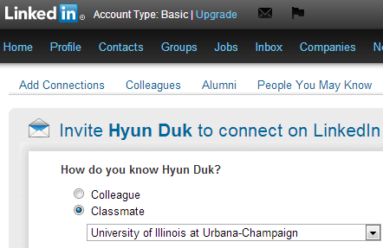
We aim to incorporate types of relationships in social network
There are different types of relationships.
Relationships are important for profiling attributes.
User: u₁
Location: Mountain View
Occupation: Google
College: Uni. of Illinois
User: u₂
Location: Cupertino
Occupation: Facebook
College: Uni. of Illinois
Classmate
Colleague
Colleague
Classmate
Unknown
Unknown
User: u₃
Location: Sunnyvale
Occupation: Unknown
College: MIT
User: u₄
Location: Mountain View
Occupation: Google
College: Stanford
User: u₅
Location: Seattle
Occupation: Microsoft
College: Unknown

Slide 63
Current methods have several limitations
Most profiling methods propagate heuristically attributes.
Several profiling methods are based on principled models, but are limited to locations.
Other network based classifications methods ignore implicit types of relationships.
Colleague
Classmates

Slide 64
We aim to design a principled co-profiling model to extend our location profiling work
Extend the location based generation model to general attribute based generation model.
Incorporate different types of relationships into the generation model.
Profile types of relationships, as they are also implicit.
User: u₁
Location: Mountain View
Occupation: Google
College: Uni. of Illinois
User: u₂
Location: Cupertino
Occupation: Facebook
College: Uni. of Illinois
Classmate
Colleague
Colleague
Classmate
Unknown
Unknown
User: u₃
Location: Sunnyvale
Occupation: Unknown
College: MIT
User: u₄
Location: Mountain View
Occupation: Google
College: Stanford
User: u₅
Location: Seattle
Occupation: Microsoft
College: Unknown

Slide 65
Future work 2: Design efficient indexes and plans to support analytic search
[ICDE’12]
Application Layer
Queries
Business Intelligence
Emergency Management
Political Analysis
Results
[In Preparation]
Query Processing Layer
Support analytical search efficiently
Complex Search Queries
Plans
Index-Plan Optimizer
Indexes
[KDD’12, VLDB’12, KDD’09]
Data Augmentation Layer
User Attributes
Attributes
User Profiler
Doc Attributes
Document Analyzer
Data Gathering Layer
[VLDB’13 Sub]
Data Corpus
Topic
Topic Focused Monitor

Slide 66
Analytic search over social media is different from document retrieval over web
Product information of Iphone 5? VS. Demographics of users who “iphone 5”
 | Document Retrieval over web | Analytic Search Over Social Media
Input | Keywords | Keyword + Restrictions
Output | Individual Documents | Fine grained information (e.g., #smartphones)
 |  | Aggregated Information (e.g., how many users mention them)

Slide 67
We aim to support complex entity search to flexibly and efficiently analyze social media
Entity Search (Cheng et.al 2007 VLDB)
Search typed entities from documents with keywords
#phone “Amazon”
#professor “databases”;
Complex Text Search
Search aggregated fine-grained information with keywords and additional restrictions.
What place do people get “donuts”
#location “donuts”
What users’ age groups do people like “iphone”.
( #age-group “iphone”, doc.sentiment=happy)
Complex Operations
Various Forms

Slide 68
Query Processing Layer: How to support complex entity search efficiently?
It is inefficient to support complex entity search based on inverted indexes.
However, most indexes are manually designed for entity search or complex text search.
They are not optimal.
They are not general.

Slide 69
Can we design an automatic approach for deriving efficient indexes to support CTS
We marry “DB” techniques to our IR setting.
Automatic methods have been proposed to derive indexes in DB.
General
Cost-based optimization.
IR setting proposes some new opportunities.
Template queries enable offline index and plan co-optimization.
Online Execution
Online Query
Results
A workload of search queries
Optimizer
Execution Plans
Offline Optimization
Index Files
Data

Slide 70
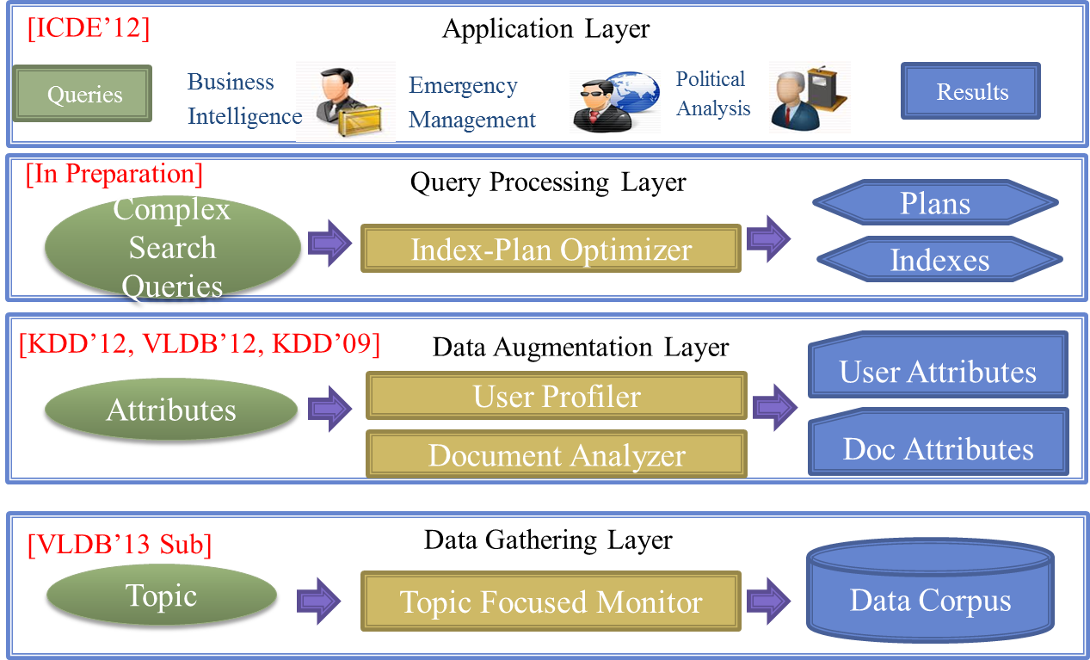
Conclusion: a general data platform to enable analyze big and noisy social media data.
Thanks!

Slide 72
Marriage of DB and IR
Extensive offline optimization for a template to derive both plans and indexes.
Light weight online optimization to select plans based on queries
Experiments show that
Our approach covers existing proposed indexes.
Our approach finds new and advanced indexes.

Slide 73
Future Plan: continue social media analysis
Bridge online social network to offline real world
Profiling Users’ attributes (e.g., occupation), preference (e.g., vegetarians) and activities (e.g., buying cars)
Analyze social media in a specific domain.
Predict movie office records according to mined information from social network.

Slide 74

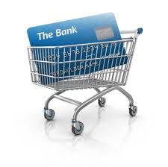
Future Plan: explore new “big” opportunities
Thanks very much!
Hybrid Data
Transaction Data
Mobile Data
Explore new opportunities in various types of big data.
My past experiences involve many related areas and deal with problems in various components of information system.
data mining, information retrieval, applied machine learning and database
crawling, mining, indexing, searching, recommending, and exploring

Slide 75
Our algorithms can improve baseline methods a lot.

Slide 76
Data Gathering Layer
Task: Monitor relevant tweets from Twitter stream for any given application (topic) (e.g., crime).

Slide 77
Data Augmentation Layer
Tasks
Profile users’ missing attributes (e.g., location) *
Analyze documents to extract entities (e.g., products) and or sentiment (e.g., positive).

Slide 78
Query Processing Layer
Task: How to derive indexes and plans to efficiently support complex text search queries
Online Execution
Online Query
Results
A workload of search queries
Optimizer
Execution Plans
Offline Optimization
Index Files
Databases

Slide 79
Search over Web vs. Analysis over Social Media
Search over web
Keyword Queries (e.g., “donuts”)
Return relevant documents matching documents,
Analysis over social media
Keywords Queries (e.g., “donuts”) with additional restrictions (e.g., gender=female)
Fine Grained Information (e.g., “user location”) extracted from documents
Aggregated Opinions from different documents

Slide 80
Supporting flexibly and efficiently analysis over social media– complex entity search
Entity Search (Cheng et.al 2007 VLDB)
Search typed entities from documents with keywords
#phone “Amazon”
#professor “databases”;
#emails “Kevin Chang”.
Complex Text Search
Search Aggregated Fine-Grained Information with keywords and additional restrictions.
What place do people get “donuts”
#location “donuts”
What users’ age groups do people like “iphone”.
( #age-group “iphone”, doc.sentiment=happy)
What smartphones do people talks in Christmas?
#smartphone “doc.time =201212”;

Slide 81
Query Processing Layer: How to support complex entity search efficiently?
It is inefficient to support complex text search
Accessing documents one by one.
We need new indexes to support
However, most indexes are manually designed.
They do not have optimal guarantee.
They cannot be adapted to different tasks.

Slide 82
An automatic approach for designing IR indexes based on DB techniques
We marry “DB” techniques to our IR setting.
DB techniques are mature.
Automatic
Cost-based optimization.
IR setting is different
Template queries
Advanced indexes
Online Execution
Online Query
Results
A workload of search queries
Optimizer
Execution Plans
Offline Optimization
Index Files
Databases

Slide 83
Marriage of DB and IR
Extensive offline optimization for a template to derive both plans and indexes.
Light weight online optimization to select plans based on queries
Experiments show that
Our approach covers existing proposed indexes.
Our approach finds new and advanced indexes.

